Slide 1
Lecture4 Part2 Discovery Phase I
Reading: Main text, Chp6; Sup text, Chp 6
Lek Hsiang Hui

Slide 2
Outline
Set Baseline
Introduction to Discovery Phase
Behavioral Analysis using use-case description

Slide 3
Set Baseline
Set Baseline
Introduction to Discovery Phase
Behavioral Analysis using use-case description

Slide 4
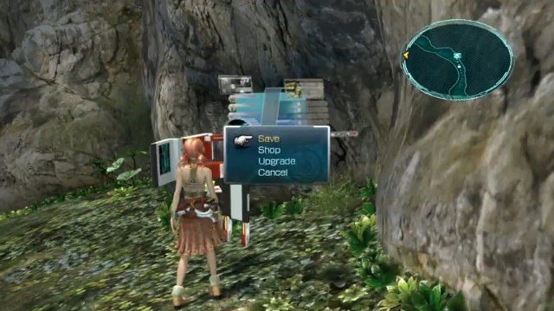
Set Baseline for Discovery
Once initiation phase is over…
Save the state of the analysis (so that we can refer back)

Slide 5

Why do we need to set baseline?

Slide 6
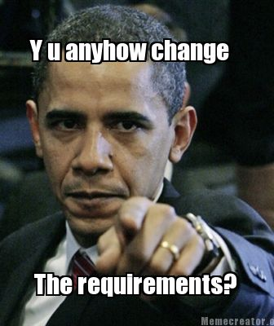

Slide 7

Phases
We can generalize SDLC into 5 different phases:
Initiation
Discovery
Construction
Final Verification and Validation
Closeout

Slide 8
Phases
We can generalize SDLC into 5 different phases:
Initiation
Discovery
Construction
Final Verification and Validation
Closeout

Slide 9
Introduction to Discovery Phase
Set Baseline
Introduction to Discovery Phase
Behavioral Analysis using use-case description

Slide 10
What have we achieved in the initiation phase?

Slide 11

Initiation Phase
Defined Project Scope

Slide 12

Discovery Phase
Ready to take project into analysis
Notes:
In iterative processes, analysis continues throughout the lifecycle; in waterfall processes, it is completed in this phase.
Please note that on an iterative project this phase may include a number of cycles, or iterations, in which case the above steps are repeated for each iteration or cycle within the phase.

Slide 13

Recall: Discovery
Can include some testing activities (validate idea)
Analyze and document requirements of project
Includes Requirements and Testing discipline

Slide 14
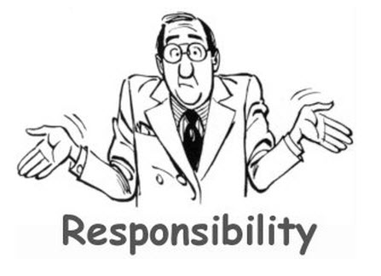
IT BA’s responsibility
Finding out the detailed requirements from the stakeholders
Analyze and document these requirements

Slide 15



Recall: Stakeholders
Person or organization affected by a project
Can be users, customers (who do not use the system directly)

Slide 16

Central Product of analysis
Result of Analysis is the Business Requirement Document (BRD)

Slide 17
Recall: BRD
A single document: Business Requirements Document (BRD)
Describe business requirements
The BRD will be revised as the project progresses
Key components of the BRD produced during the Initiation phase include:
Business use-case descriptions include business use-case diagrams
Role map
System use-case diagram
Initial class diagram describing key business classes

Slide 18

Business Requirement Document (BRD)
So it’s important that all the requirements are documents completely and correctly)
Acts as a contract between the business and the developer
If a requirement is not found in the BRD => it’s not part of the contract

Slide 19

Steps in Discovery Phase
1. Perform Behavioral Analysis
Describe the system use case (use-case description)
Describe state behavior (state-machine diagram)
Another term for state-machine diagram = state chart (will be used interchangeably)

Slide 20
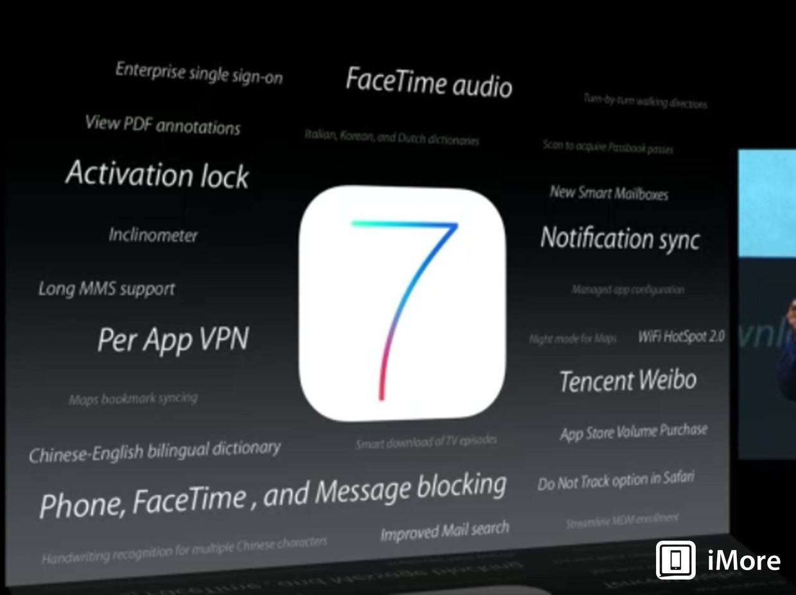
Recall: Behavioral Modeling
What does the system do?
What are the features?

Slide 21

Use case description contains more information than just the use cases
Didn’t we covered use case diagrams that models what the system does?

Slide 22
Steps in Discovery Phase
2. Perform Structural Analysis
(class diagram)

Slide 23
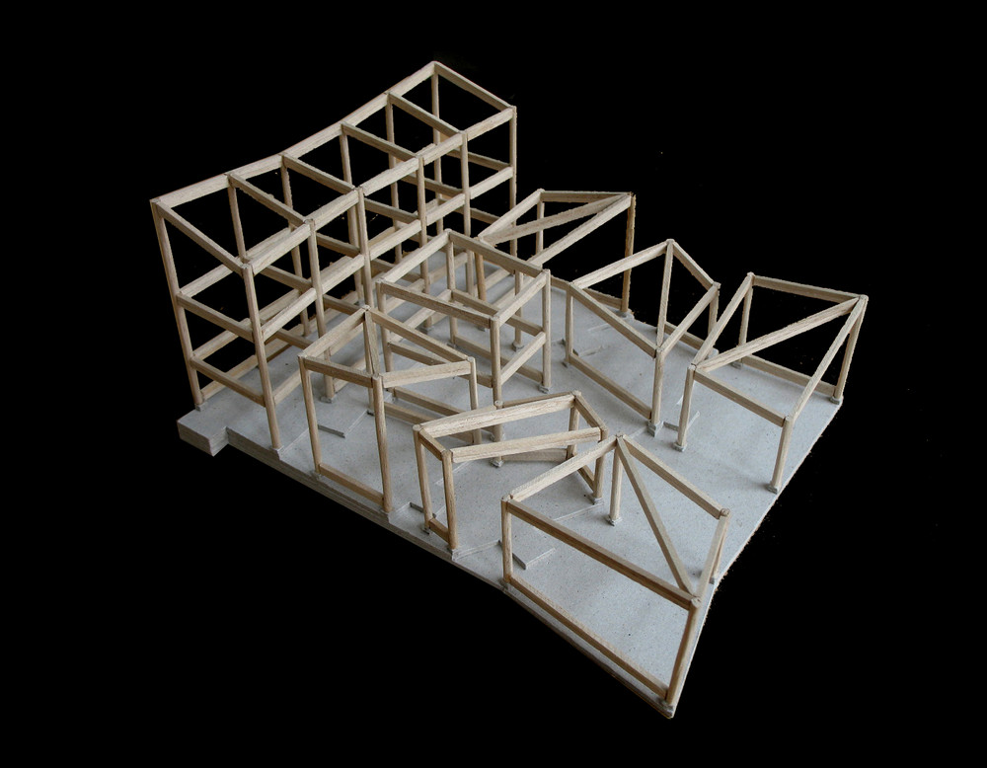
Recall: Structural Modeling
What is the system?
What are the components?

Slide 24

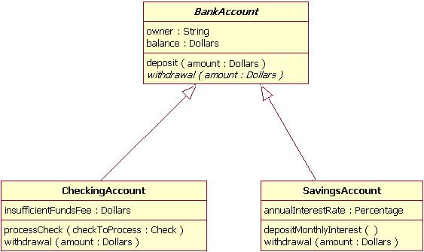
Sneak Preview: Class Diagram

Slide 25
Steps in Discovery Phase
3. Specify test plan

Slide 26
Steps in Discovery Phase
4. Specify implementation plan

Slide 27
Steps in Discovery Phase
5. Set baseline for development

Slide 28
Recall : Set Baseline
Once phase is over…
Save the state of the analysis (so that we can refer back)

Slide 29
Behavioral Analysis

Slide 30

Behavioral Analysis
Analyze and document:
Details of system use case (use-case description)
State behavior (state-machine diagram)

Slide 31
Behavioral Analysis using use-case description
Set Baseline
Introduction to Discovery Phase
Behavioral Analysis using use-case description

Slide 32
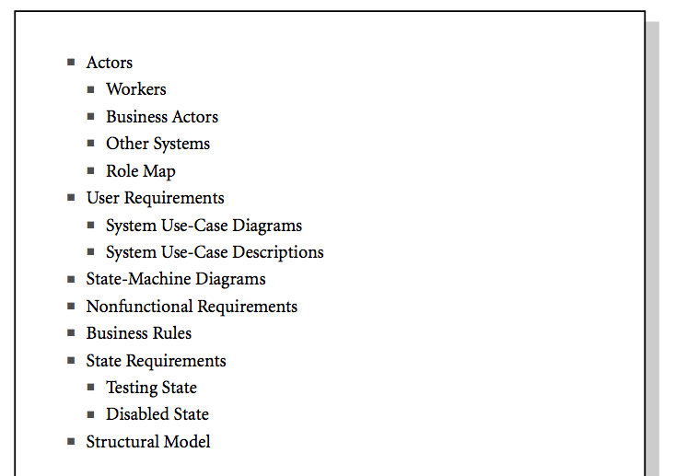
Section for use-case diagrams
Section for use-case descriptions

Slide 33
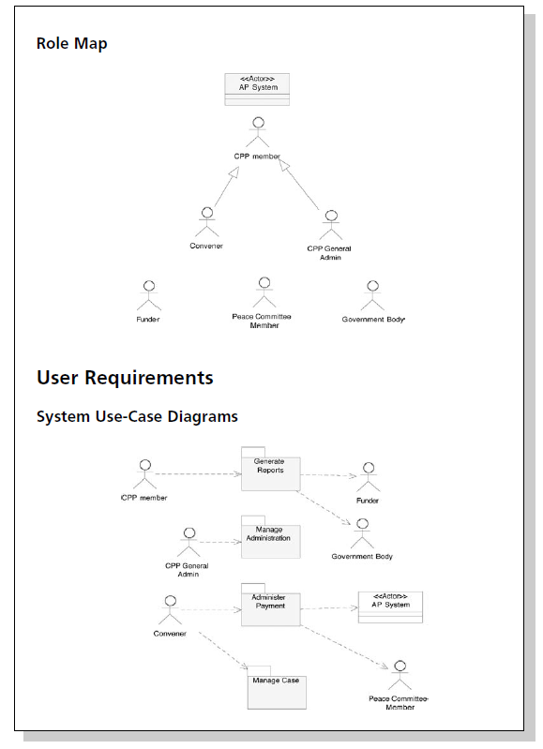
System Use Cases
What we have covered in Lecture 3

Slide 34
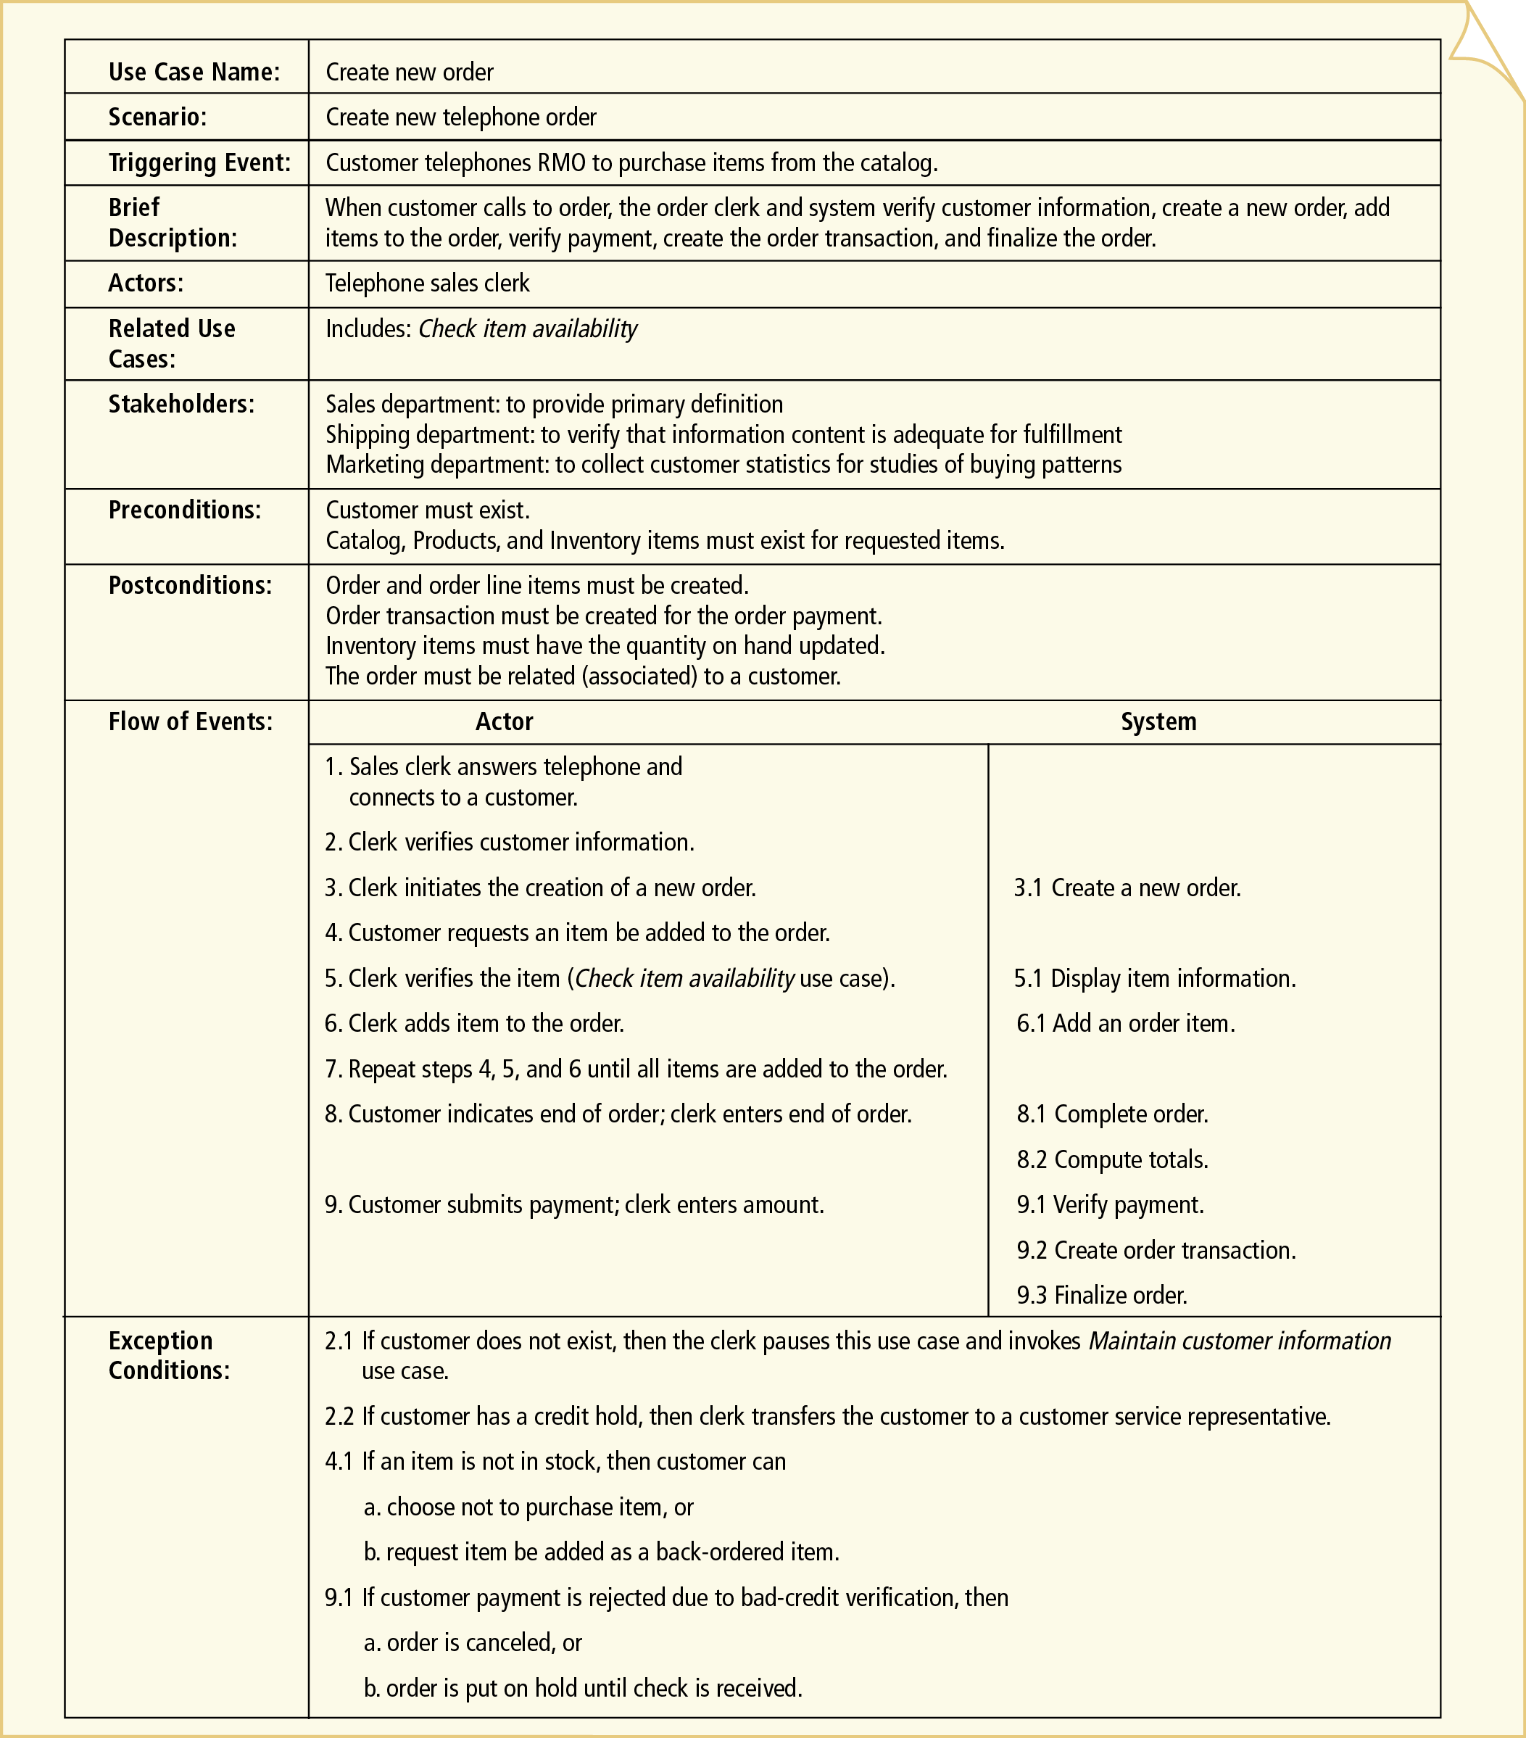
Use Case Description
IS2102 Requirements Analysis and Design
Notes:
34

Slide 35
Basic Flow

Slide 36
Basic Flow
Describe the most common flow
Should not list any conditional cases
IS2102 Requirements Analysis and Design
Notes:
36

Slide 37
Basic Flow (List form)
2. Flow of Events
Basic Flow:
2.1 The system displays a list of resolved cases that have not been reviewed.
2.2 The user selects a case.
2.3 The system validates that the case is payable. (12.1)
2.4 The system determines the payment amount. (12.1)
2.5 The system marks the case as payable.
2.6 The system records the payment amount.
2.7 The system checks the Cash fund records to ensure that adequate funds exist.
2.8 The system records the fact that the case has been reviewed.
…
IS2102 Requirements Analysis and Design
Notes:
37

Slide 38
Basic Flow Example
System use case: Review Case Report – a task that enables a user to review a case report and disburse funds against cases that qualify for payments
2. Flow of Events
Basic Flow:
2.1 The system displays a list of resolved cases that have not been reviewed.
2.2 The user selects a case.
2.3 The system validates that the case is payable. 2.4 The system determines the payment amount. 2.5 The system marks the case as payable.
2.6 The system records the payment amount.
2.7 The system checks the Cash fund records to ensure that adequate funds exist.
2.8 The system records the fact that the case has been reviewed.
…
Notes:
Use-Case Writing Guidelines Put into MS Word pg 109-110
The trick to keeping things simple is to handle variations in a separate area of the document rather than in one all-encompassing section.
First, you document a normal, typical interaction in a section called “Basic Flow”.
Next, you describe alternative success scenarios in an “Alternate Flows” section.
Finally, you describe error handling in an “Exceptional Flows” section.

Slide 39

Basic Flow
Describe the most common flow
Should not list any conditional cases
What if we want to show the conditional cases?
IS2102 Requirements Analysis and Design
Notes:
39

Slide 40
Alternate Flow

Slide 41

Alternate Flows
For documenting each scenario not covered in the basic flow

Slide 42
Typical Alternate Flows
User select an alternative option
Login fails
Inventory quantity is 0 (cannot process order)
etc

Slide 43
Alternate Flow Documentation
Trigger: The event or condition that causes the process to be diverted from the basic flow
Divergence point: The point within the basic flow from which the process jumps to the alternate flow
Convergence point: The point at which the process returns to the basic flow

Slide 44
Alternate Flow Example
2. Flow of Events
Basic Flow:
.1 The system displays a list of resolved cases that have not been reviewed.
.2 The use selects a case.
.3 The system validates that the case is payable.
.4 The system determines the payment amount.
.5 The system marks the case as payable.
.6 The system records the payment amount.
.7 The system checks the Cash fund records to ensure that adequate funds exist.
.8 The system records the fact that the case has been reviewed.
Alternate Flows:
2.3a Non-payable case:
.1 The system marks the case as non-payable.
.2 The user confirms the non-payable status of the case.
.3 Continue at step 8.
2.7a Cash funds low but sufficient:
.1 The system marks the case as payable.
.2 The system displays the low-funds warning. (see “Prompts and Messages.”)

Slide 45
What if there are other ways that an alternate-flow step could play out?
Document these the same way you documented the original alternate flows

Slide 46
Alternate Flow Example
2. Flow of Events
Basic Flow:
.1 The system displays a list of resolved cases that have not been reviewed.
.2 The use selects a case.
.3 The system validates that the case is payable.
.4 The system determines the payment amount.
.5 The system marks the case as payable.
.6 The system records the payment amount.
.7 The system checks the Cash fund records to ensure that adequate funds exist.
.8 The system records the fact that the case has been reviewed.
Alternate Flows:
2.3a Non-payable case:
.1 The system marks the case as non-payable.
.2 The user confirms the non-payable status of the case.
.3 Continue at step 8.
2.3a.2a User overrides non-payable status:
.1 The user indicates that the case is to be payable and enters a reason for the override.
…
2.7a Cash funds low but sufficient:
.1 The system marks the case as payable.
.2 The system displays the low-funds warning. (see “Prompts and Messages.”)

Slide 47
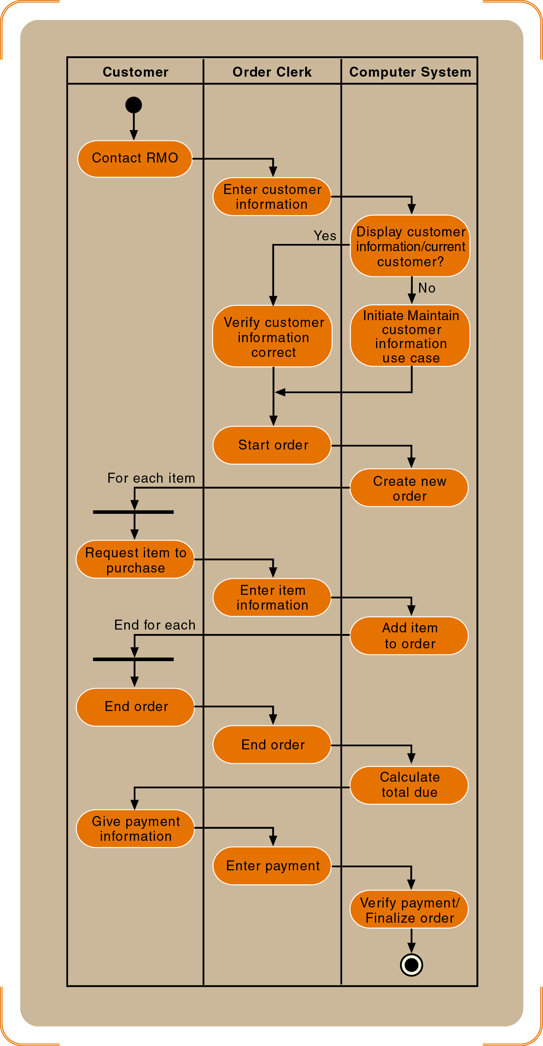
Activity Diagrams for System Use Cases
If the flows are too complicated, consider using activity diagrams

Slide 48
Related Artifact
System use case: Review Case Report – a task that enables a user to review a case report and disburse funds against cases that qualify for payments
Step 2.3 and 2.4 refer the reader to 12.1, a decision table that describes the rules for making payments
2. Flow of Events
Basic Flow:
2.1 The system displays a list of resolved cases that have not been reviewed.
2.2 The user selects a case.
2.3 The system validates that the case is payable. (12.1)
2.4 The system determines the payment amount. (12.1)
2.5 The system marks the case as payable.
2.6 The system records the payment amount.
2.7 The system checks the Cash fund records to ensure that adequate funds exist.
…
12. Other Related Artifacts
12.1 Case Payment Decision Table (link to table)

Slide 49
Describe System Use Cases
The text documentation may be augmented with:
Activity diagrams
Decision tables/trees
Other related artifacts e.g. User Interface, Prompts and Messages, Business Rules, Class Diagrams, Information Items, Related Artifacts
Notes:
Use-Case Description Template Pg 106 to 108
At the end of Initiation phase, system use cases have been identified in BRD.
The BRD was baselined for the Discovery phase.
By baselining the BRD, you ensured that you have a reference point to go back to.
Updates on the BRD during the Discovery phase are made on a new working version.

Slide 50
Related Artifacts
Notes:
Thành phần lạ

Slide 51
Related Artifacts
The BRD also contains a “Related Artifacts” section where you can use to provide more information about some points in the use case
E.g. One of the steps says “System validates eligibility”
You want to inform what qualifies as eligible => add this in the related artifacts

Slide 52
Related Artifacts
Benefits:
Separate the details from the main use case
Makes the use case description more complete
3 possible techniques
Decision Tables
Decision Tree
Condition/Response Table

Slide 53
Example of a Use Case with a Decision Table
System use case: Process Life Insurance Application
2. Flow of Events
Basic Flow:
.1 User enters application information.
.2 System validates eligibility. (12.1)
.3 System adds application to adjuster queue.
Alternate Flows:
…
12. Other Related Artifacts
12.1 Validate Eligibility Decision Table (link to table)

Slide 54
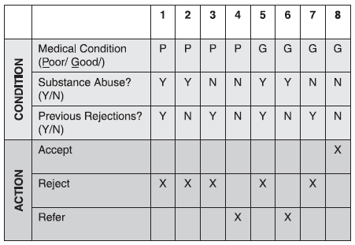
Example of a Use Case with a Decision Table
12.1 Validate Eligibility Decision Table

Slide 55
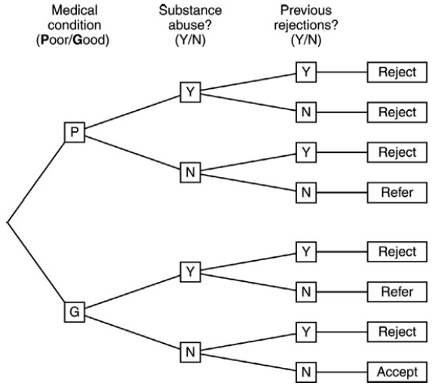
Decision Trees

Slide 56
Condition/Response Table
System use case: Prepare Taxes
Basic Flow:
…
11. The user enters net income.
12. The system determines tax bracket. (see Tax Bracket condition/response table in Appendix A.)
13. The system displays tax bracket.
…
Appendix A:
Tax bracket condition/response table:
Condition Response
Under minimum No tax payable
Minimum-$18,000 Tax bracket A
$18,000.01-$60,000 Tax bracket B
$60,000.01-$500,000 Tax bracket C
Over $5000,000 Tax bracket D
If the input conditions can be evaluated one by one

Slide 57
OTHER FIELDS

Slide 58
Use Case NAME
The use case in the use case diagram
IS2102 Requirements Analysis and Design
Notes:
58

Slide 59
SCENARIO
Can be similar to the use case name
IS2102 Requirements Analysis and Design
Notes:
59

Slide 60
Triggering Event
The event that will trigger this use case
IS2102 Requirements Analysis and Design
Notes:
Gây ra
60

Slide 61
Brief Description
Give a more complete description to supplement the Trigger Event
IS2102 Requirements Analysis and Design
Notes:
61

Slide 62
Actors
The actor that will execute the use case (i.e. the person/system that will be doing this use case)
IS2102 Requirements Analysis and Design
Notes:
62

Slide 63
Related Use Cases
IS2102 Requirements Analysis and Design
Notes:
63

Slide 64
Stakeholders
Parties that will be interested in this use case (actors can be considered as part of the list)
IS2102 Requirements Analysis and Design
Notes:
64

Slide 65
Preconditions
This defines the state of the system before this use case can be executed
IS2102 Requirements Analysis and Design
Notes:
65

Slide 66
Postconditions
This defines the state of the system after this use case is executed
(Note: this is not the return result)
IS2102 Requirements Analysis and Design
Notes:
66

Slide 67


Slide 68
What’s Next?
Advanced features of Use Case diagrams
System Sequence Diagram
State Machine Diagrams

